Slide 1

TEAM:OUR CRAFT
SMART PLANT CARE SYSTEM
by Yunchen Zhang, Mingkai Ban, Yanxu Wu

Slide 2

INTRODUCTION
The aim of our project is to develop an innovative solution to the problem of manual watering by creating an automatic plant watering system.
The system will utilize the ESP32 microcontroller and a humidity sensor to detect soil moisture levels and trigger watering only when necessary. By automating plant care, we aim to make it more efficient, convenient, and cost-effective.
user-friendly interface that can be accessed remotely from any device with internet access. The interface will provide real-time information on soil moisture levels, watering schedules, and other relevant data. To ensure the security of the system, we will implement a user login system that protects user data and prevents unauthorized access.

Slide 3
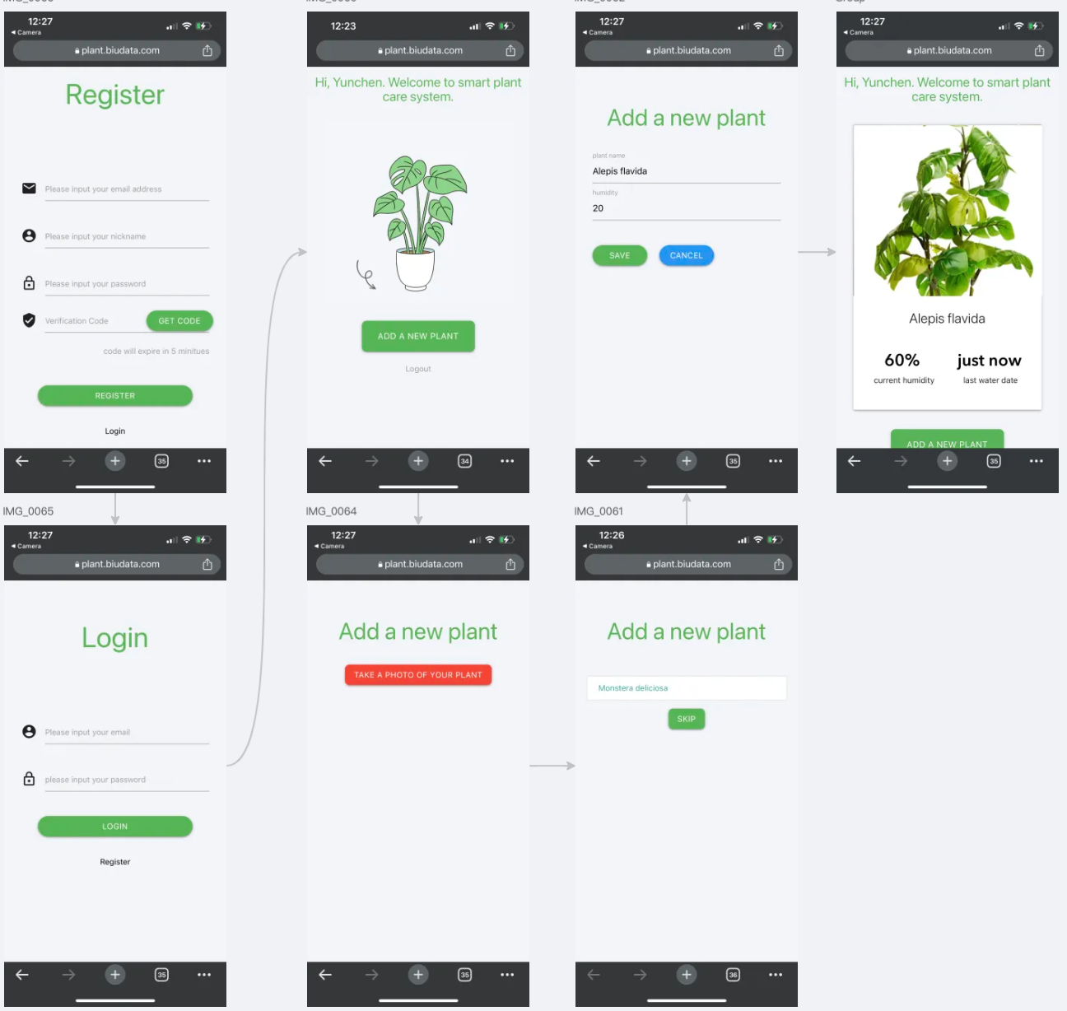
FRONT END

Slide 4
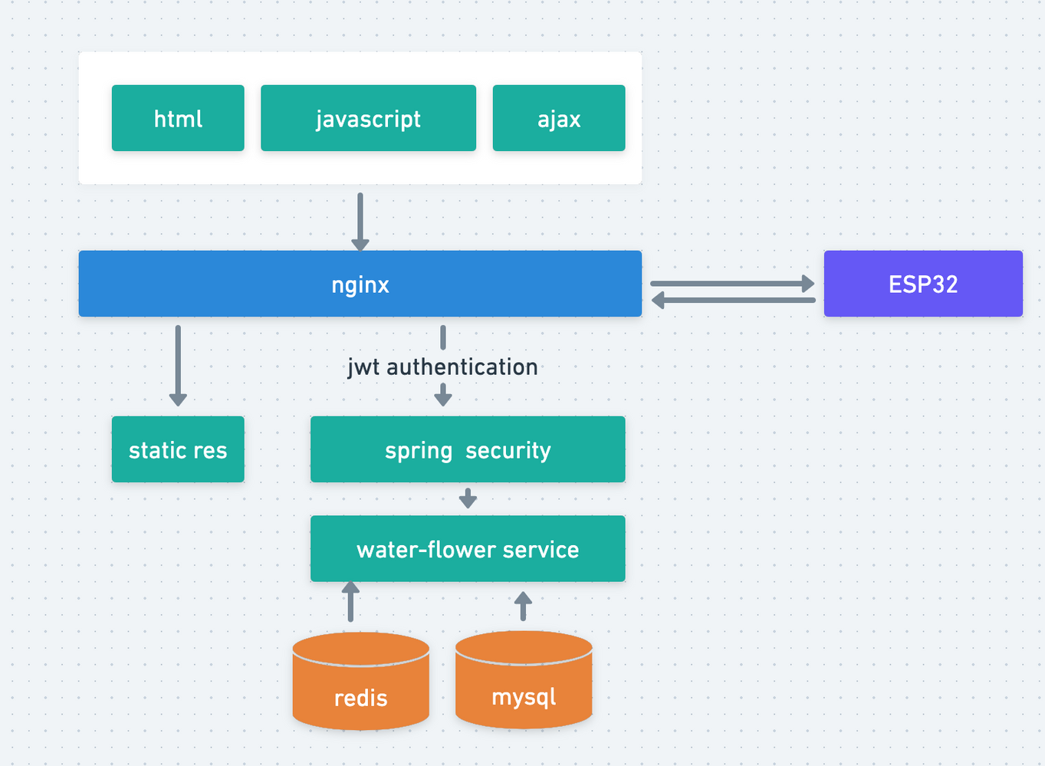



SOFTWARE DESIGN (BACK END)

Slide 5
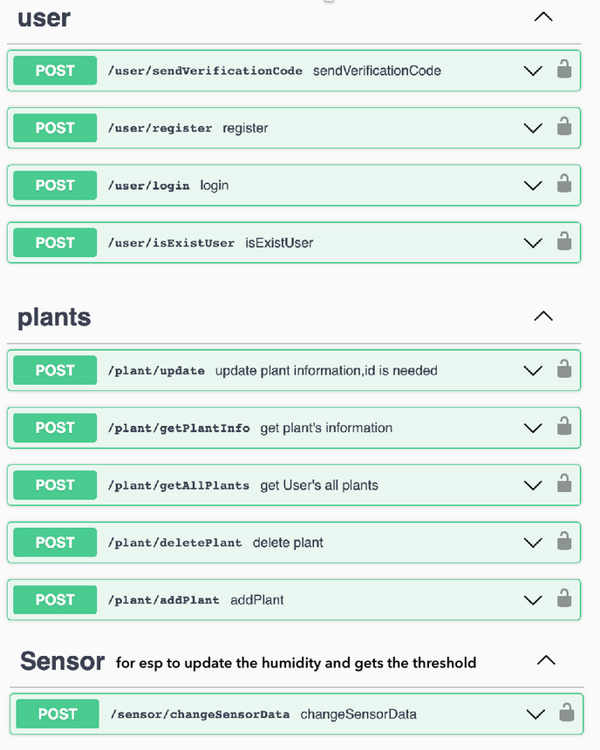
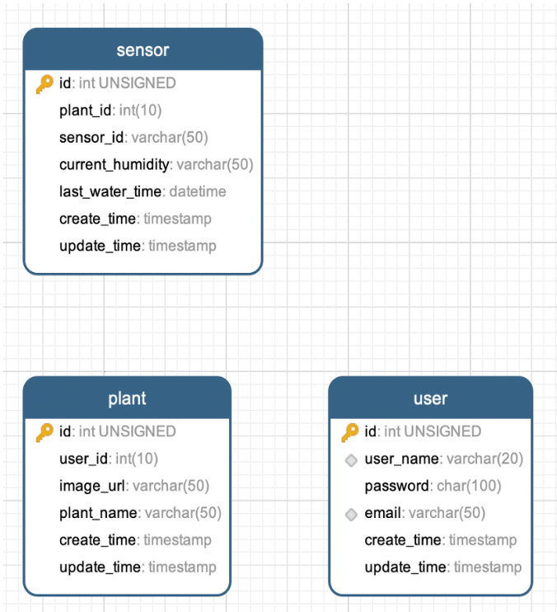
APIS & DB

Slide 6
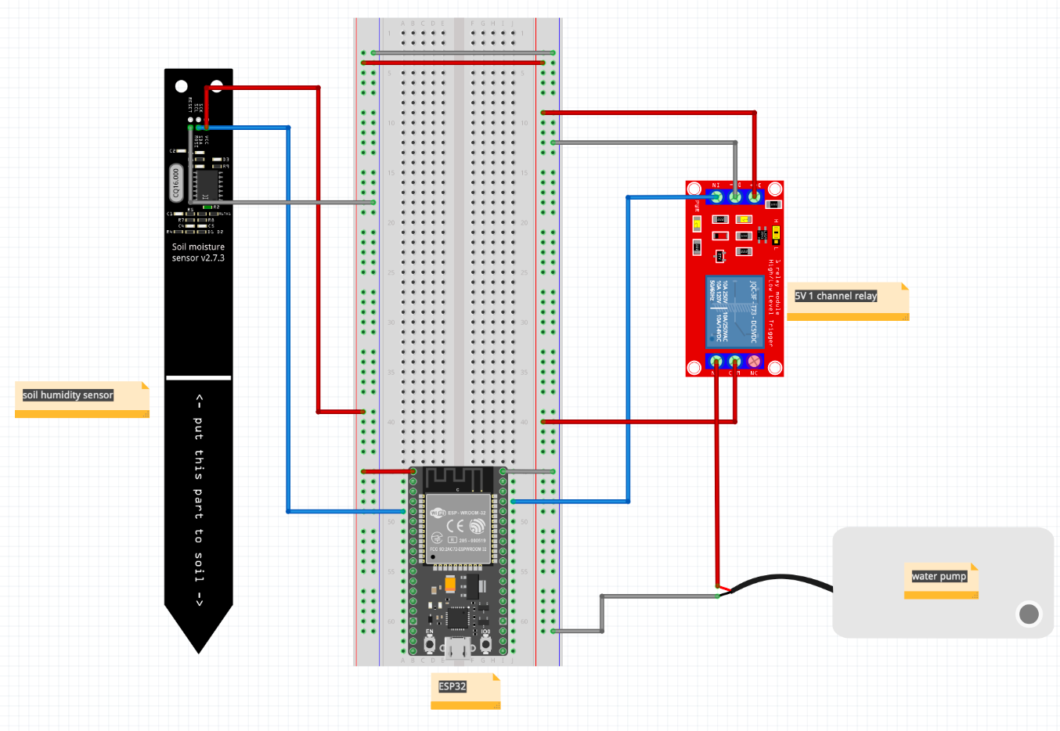

HARDWARE DESIGN

Slide 7
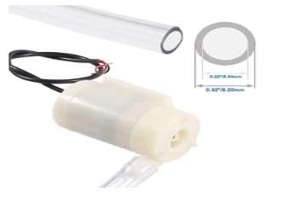
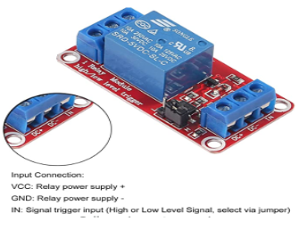
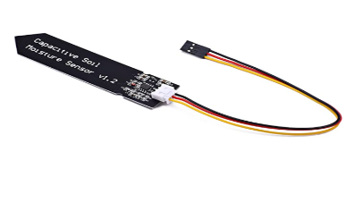
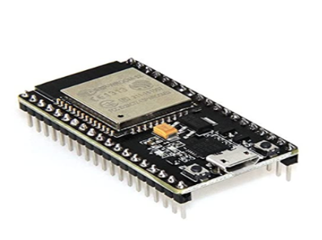
HARDWARE LIST
water pump
one channel relay
soil miosture
micro control
Sipytoph DC 3-5V Micro Submersible Mini Water Pump
ALMOCN DC 5V 1 Channel Relay Module With Optocoupler Isolation Support High or Low Level Trigger
Songhe Capacitive Soil Moisture Sensor Module Corrosion Resistant 3.3~5.5V W/Gravity for Arduino Moisture Detection Garden Watering
HiLetgo ESP-WROOM-32 ESP32 Development Board
SMART PLANT CARE

Slide 8
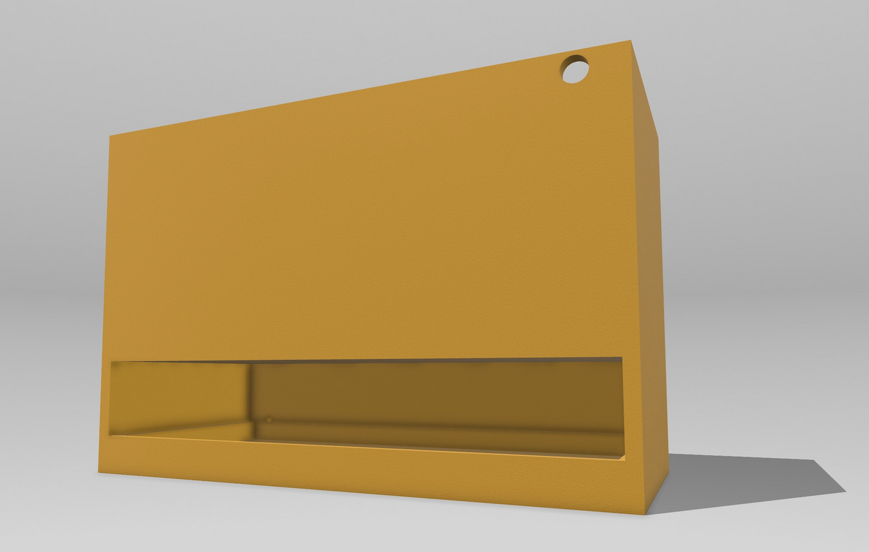

3D PRINTER
need support line

Slide 9
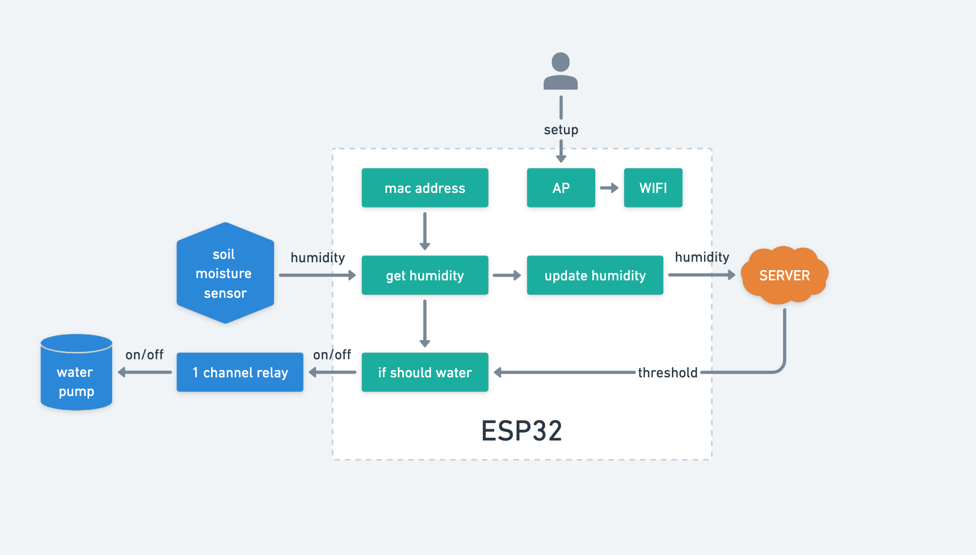
SOFTWARE DESIGN (FIRMWARE)

Slide 10
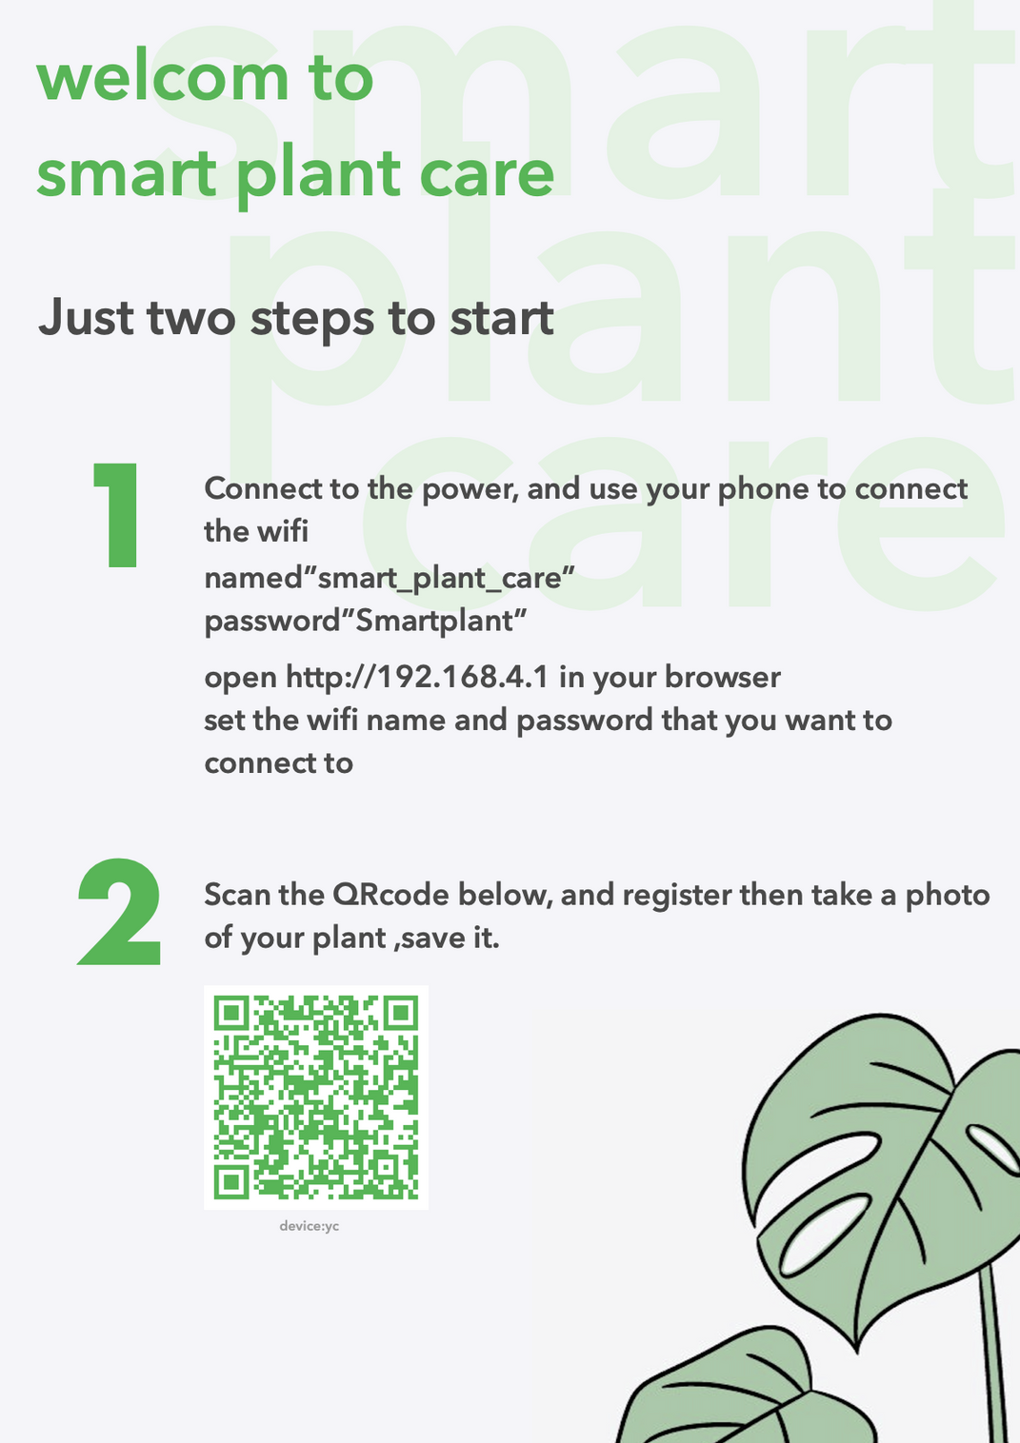
DEMO

Slide 11
CONCLUSION
Our project created an automatic plant watering system that provides optimal moisture levels for plants while conserving water and reducing manual effort.
We used sensors to monitor soil moisture and weather conditions, and the system has a user-friendly interface accessible from any device with internet access.
Our project showcases the potential of IoT technology in creating sustainable solutions for agriculture and plant care, benefiting plant enthusiasts, gardeners, and farmers.

Slide 12

any questions?
Yunchen Zhang, Mingkai Ban, Yanxu Wu

